Slide 1
DrinkTank Present
Phil The automated bartender
Aaron Riggs, Andre Manz, Chris Baierski, Wesley Scott as
Notes:
Wes

Slide 2
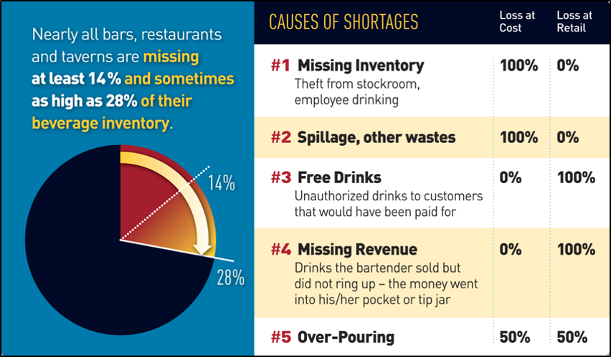
The Problem
In the nightlife industry one of the largest losses comes from inventory waste and loss.
Roughly 20% of inventory loss is due to free drinks, overpuring and theft
70% of these losses are at retail value
30% at customer cost
With industry sales at over $700 billion a year a ~20% loss is significant
http://blog.sculpturehospitality.com/blog/70-of-bar-losses-are-at-retail-value-inventory-control
Notes:
Wes

Slide 3
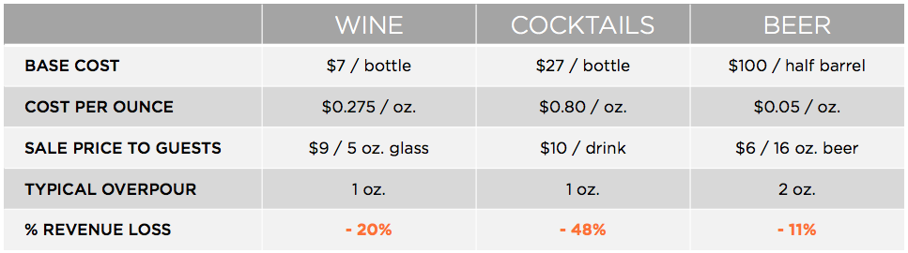
The Problem Cont.
Math behind the overpuring sales losses.
With only .5oz overpoured liquor in a cocktail can mean up to a 48% loss on the bottle.
This can lead to over $20,000 in lost revenue over the course of a year.
Accurate pouring can be hard to eyeball for bartenders.
https://www.sestrasystems.com/overpouring-drains-beverage-profits/
Notes:
Wes

Slide 4
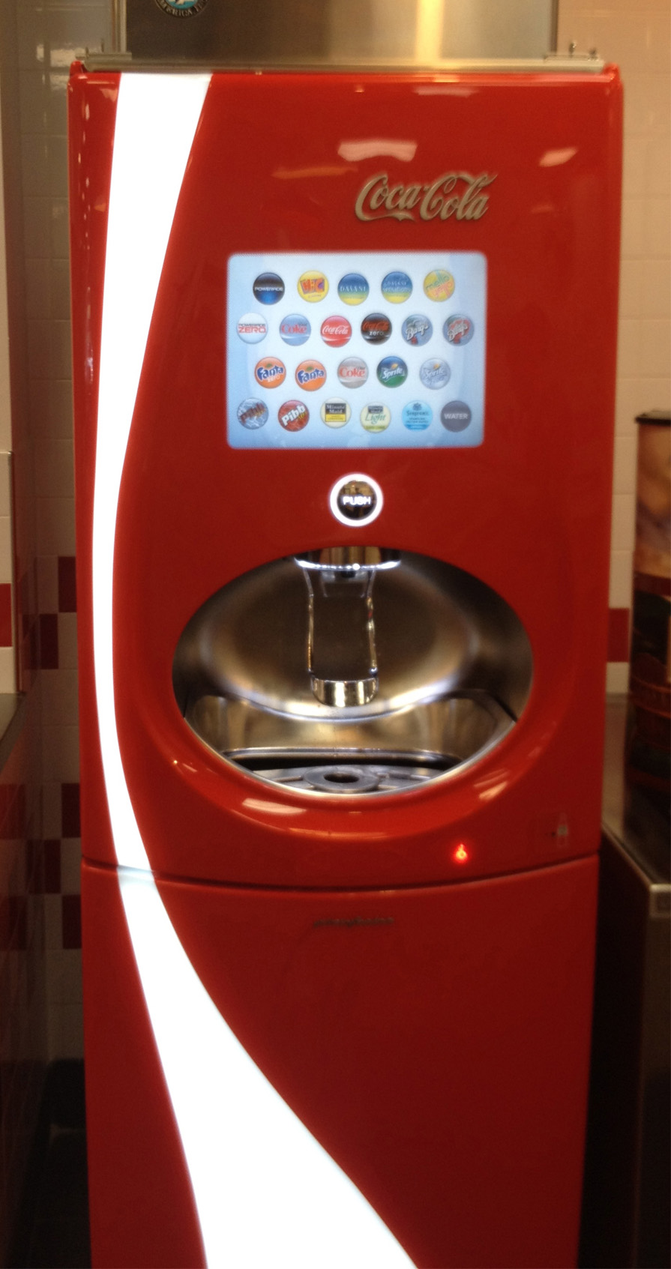
Inspiration
Automated coke machines
Bar rescue
Industry loss to portion control
Industry loss to accidental free drinks
The pure novelty of it
Notes:
Andre

Slide 5
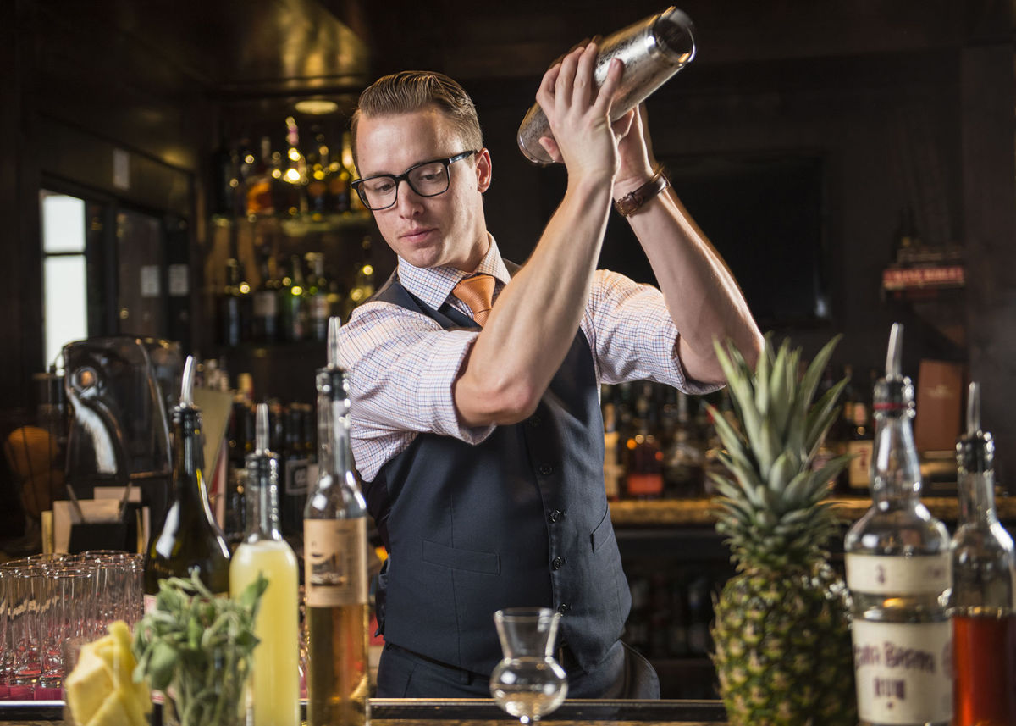
The solution
Phil the automated bartender!
Control Liquor cost by reducing over pours, spills and free drinks!
Make the most popular drinks hands free!
Reduced time that bartenders spend making the simple drinks!
Shorten the line at the bar!
Reduce necessity for restaurant staff to make drinks rather than serving customers
Notes:
Chris

Slide 6
The Product features : Phil
Goals
Able to pour 2-part drinks like whiskey-coke’s in measured amounts.
Able to keep a detailed record of the drinks made.
Perform business logic on “Phil”’s usage (profits made, usage statistics, etc.)
Fully portable unit ready for most jobs in minutes.
Self cleaning.
Admin area to add, remove and modify drinks.
Long Goals
Able to make 3 or even 4-part drinks.
Have an embedded payment system.

Slide 7
Product Planning
Raspberry PI for the brain
Pumps and valves to pour
Integrated self cleaning system using isopropyl and water
Pulls directly from liquor bottles to minimize set-up
Enclosed case to prevent tampering

Slide 8
Expected outcomes
The pouring of standard drinks.
The customization of the drinks to be poured by an admin.
The ability to monitor drinks that have been served.
The pouring of custom designed drinks by the admin.
The tracking of Phil’s usage

Slide 9
Phil - The automated bartender
Thanks for your time!
Any Questions?

